Slide 1


Slide 2
REACT JS
ADACODE SOLUTIONS

Slide 3
REACT JS
It is a JavaScript library for building user interfaces.
It is the view layer for web applications.
Developed at Facebook and released to the world in 2013,
It drives some of the most widely used apps, powering Facebook and Instagram among countless other applications.
Ideal for building single-page applications (SPAs) and interactive web applications.

Slide 4
Single Page Web Applications
A Single-Page Application (SPA) is a web application or website that interacts with the user by dynamically rewriting the current page rather than loading entire new pages from the server.
In SPAs, the initial HTML, CSS, and JavaScript are loaded once, typically during the initial page load, and subsequent interactions with the application are handled by JavaScript, which fetches data from the server and updates the page content without requiring a full page reload.

Slide 5
Key characteristics of SPA
No Page Reloads: SPAs do not trigger full page reloads when a user interacts with the application. Traditional multi-page applications (MPAs) often require the entire page to be refreshed when navigating between different parts of the site.
Dynamic Loading: SPAs load and render content dynamically. When a user clicks on a link or interacts with the interface, the application uses JavaScript to fetch and update only the necessary data and UI components, resulting in a smoother and faster user experience.
Client-Side Routing: SPAs often implement client-side routing using JavaScript libraries or frameworks. This allows for the creation of distinct routes or URLs within the application without requiring server-side changes.

Slide 6
React is a Library?
library typically refers to a collection of pre-written code, functions, and components that developers can use to build user interfaces (UIs) for web applications.
React itself is often referred to as a library because it provides a set of tools and components for building UIs efficiently.

Slide 7
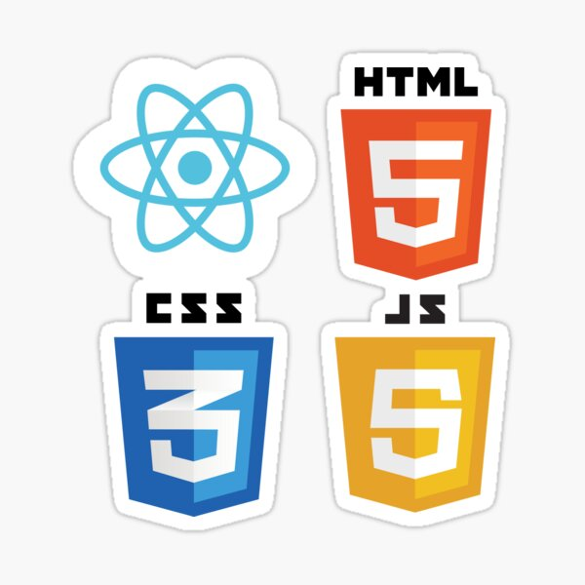

Slide 8
Features of REACT JS
Easy to learn
Simple
Native approach
Data binding
Performance
Testability

Slide 9
Which Popular Sites Use ReactJS?
FACE BOOK
INSTAGRAM
NETFLIX
WHATSAPP
YAHOO MAIL
DROP BOX

Slide 10
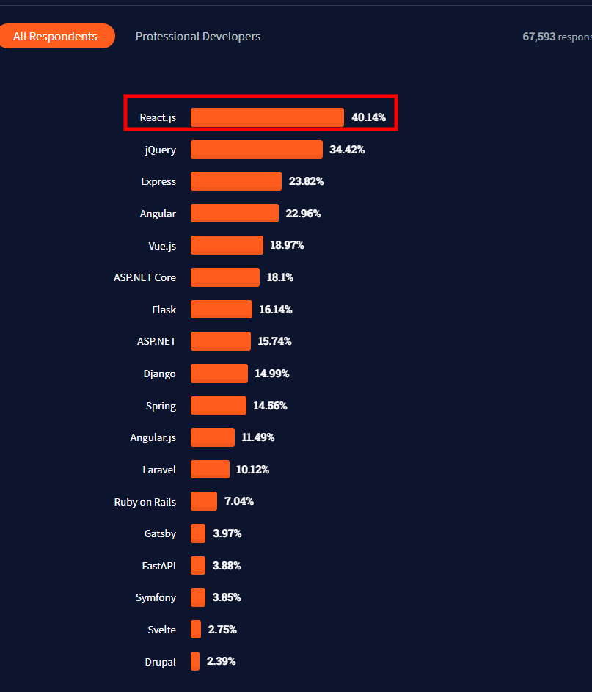

Slide 11
ReactJS — Installation
React CLI tools depends on the Node.js and must be installed in your system.
node –v
Create React App is a modern CLI tool to create single page React application.
npm install -g create-react-app
create-react-app my-app
cd my-app
npm start

Slide 12
ReactJS — Installation
Better way
npx create-react-app myapp
cd my-app
npm start
The npx stands for Node Package Execute
Check the current version of React Js
npm view react version

Slide 13
Components
React app starts with a single root component.
Root component is build using one or more component.
Each component can be nested with other component to any level.
Most of the components are user interface components.
React app can include third party component for specific purpose such as routing, animation, state management, etc.

Slide 14
Component
The primary job of a React component is to render its user interface and update it whenever its internal state is changed.
React component provides below functionalities.
Initial rendering of the user interface.
Management and handling of events.
Updating the user interface whenever the internal state is changed.

Slide 15
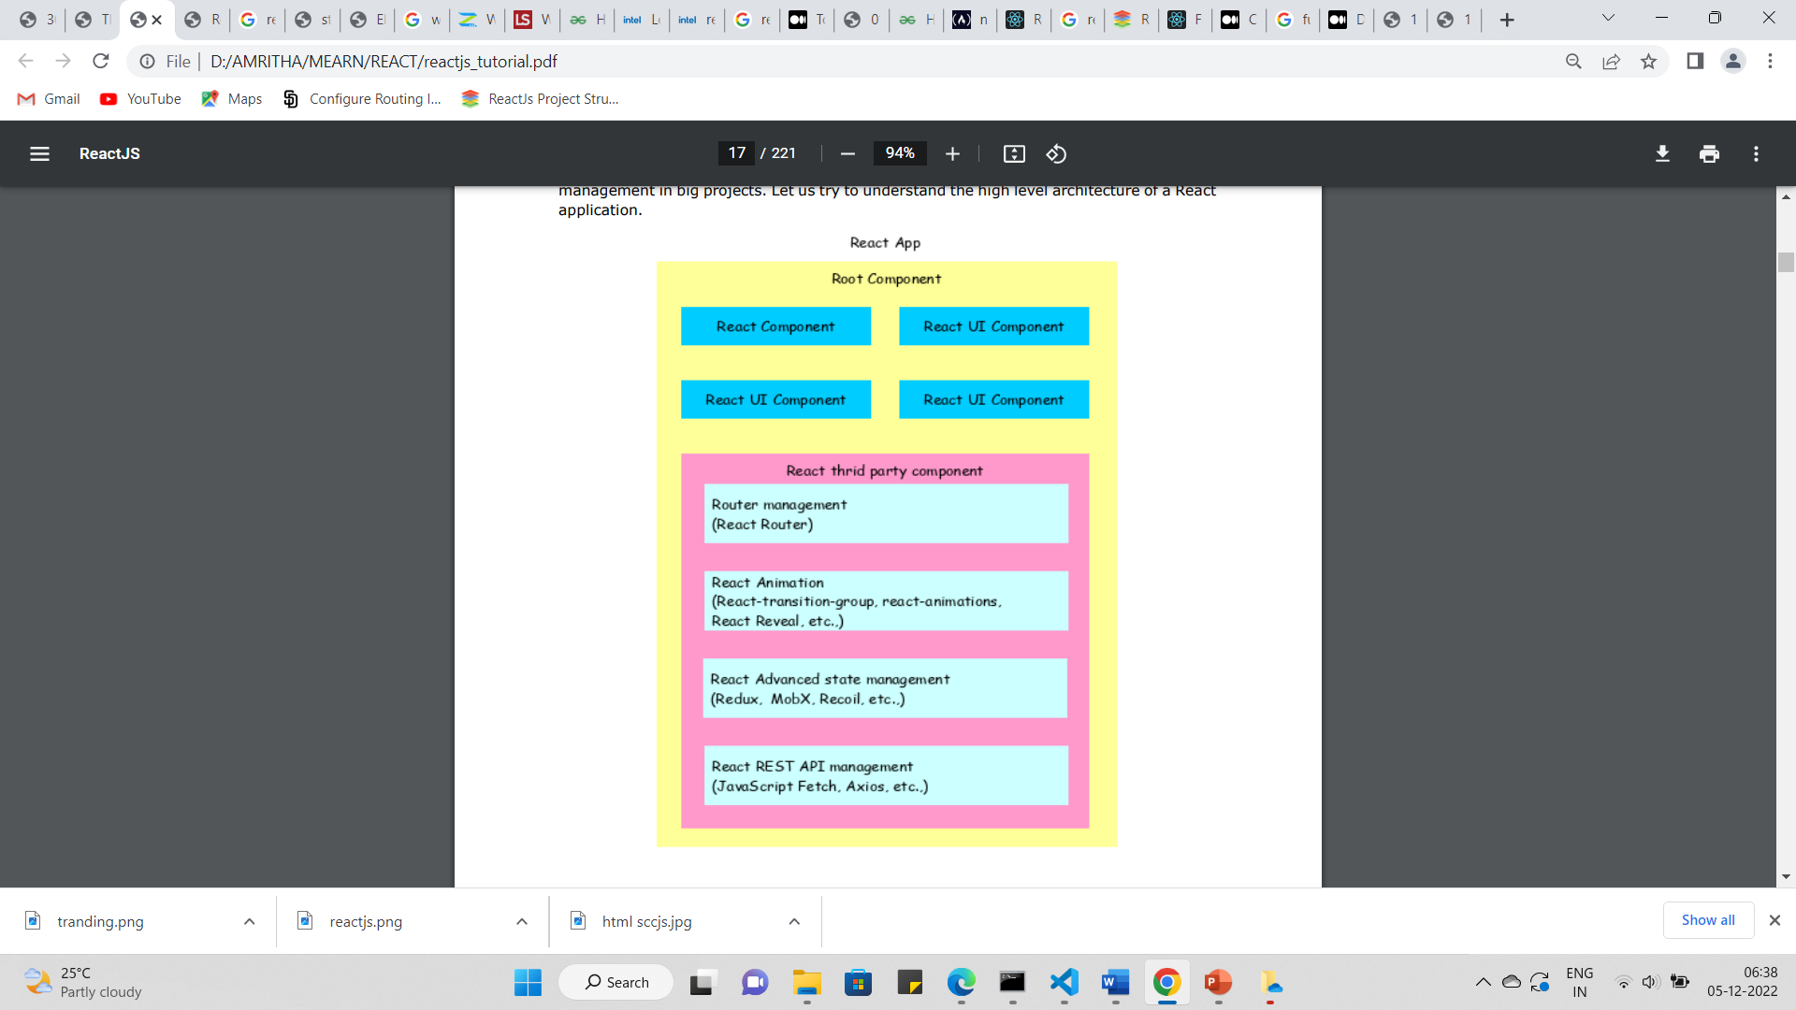
Understand the high level architecture of a React application

Slide 16
Folder structure
node_modules(Folder)
Contains all the dependencies that are needed for an initial working react app
.gitignore(file)
This file specifies intentionally untracked files that Git should ignore
package.json(file)
This file contains various metadata that is relevant to our project.
It specifies the dependencies being used in the project which helps npm setup same environment on different machine for our project
README.md(file)
This file can be used to define usage, build instructions, summary of project, etc. It uses markdown markup language to create content.

Slide 17
Public folder and it’s files
public(folder)
Root folder that gets served up as our react app.
favicon.ico(file)
It’s an icon file that is used in index.html as favicon.
index.html(file)
It is the template file which is served up when we run start script to launch our app. It is considered best practice not to create multiple html file in public folder instead use this file and inject react components in this file’s root div container. Other css libraries, etc can be defined in this files.

Slide 18
logo192.png & logo512.png(files)
These are react logo which is of dimension 192*192 px and 512*512 px and is used in the template file (index.html) by default. [can be removed once you are using your own component]
manifest.json(file)
It’s used to define our app, mostly contains metadata. Used by mobile phones to add web app to the home-screen of a device. Part of PWA.
robots.txt(file)
Defines rules for spiders, crawlers and scrapers for accessing your app.

Slide 19
Src folder and its files
src(folder)
In simplest form it’s our react app folder i.e. containing components, tests, css files etc. It’s the mind of our app.
App.css(file)
Contains styles of our react component(App.js)
App.js(file)
This file has very basic react component defined which can be replaced by our own root component
App.test.js(file)
A very basic test(for the default app) is defined in this file which can be replace by our own tests. [make use of Jest]

Slide 20
index.css(file)
Contains styles for general setup of our app.
index.js(file)
This files renders our component and registers service workers(unregistered by default)
logo.svg(file)
Svg file of react logo, being used in component(App.js) by default.
setupTests.js(file)
As the name suggest this files setups tests and runs them. This file in directly invoked when we run tests from cli(npm run test).[make use of Jest]

Slide 21
Task
What is npm?
What is the difference between npm and npx?
What is the difference between framework and library

Slide 22
Thank You

